Slide 1
R Project
CIS663-01-SP24
Analysis of Youtube Video trends for efficient prediction of future markets.
By: Kaushal Guragain
M00361014
CIS663-01-SP24

Slide 2
Thing I have done so far
Simple Data cleaning, transformation, and loading.
Data manipulation from string to numbers to easier statistical calculation.
Some visualization of data
Spearman's test (1,2,3 were done for getting to step 4)

Slide 3
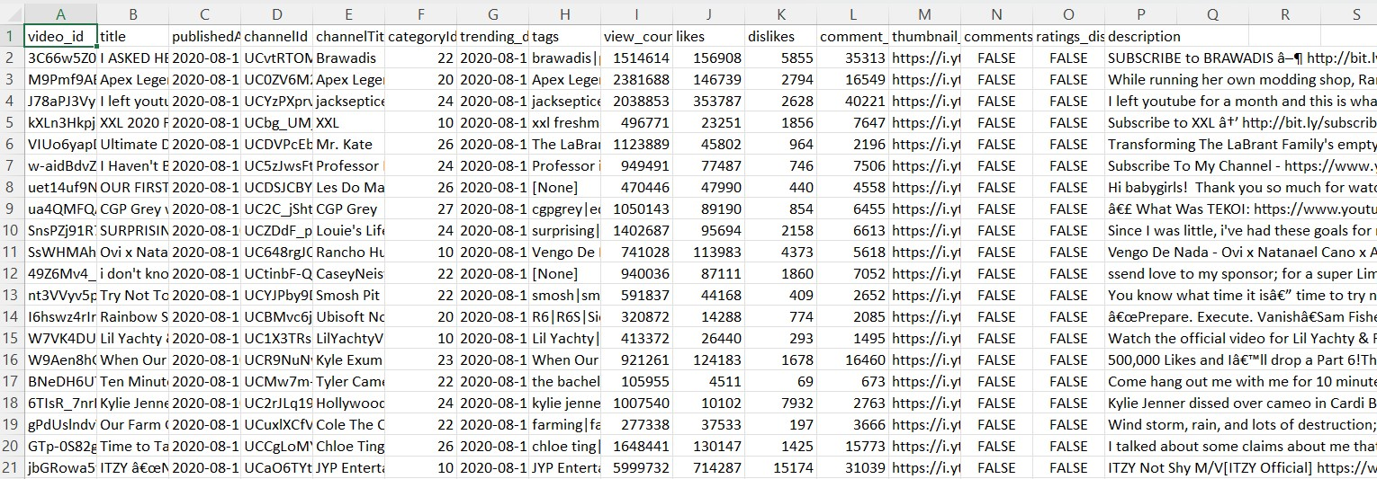
Cleaning, Transforming, loading
My initial dataset.

Slide 4
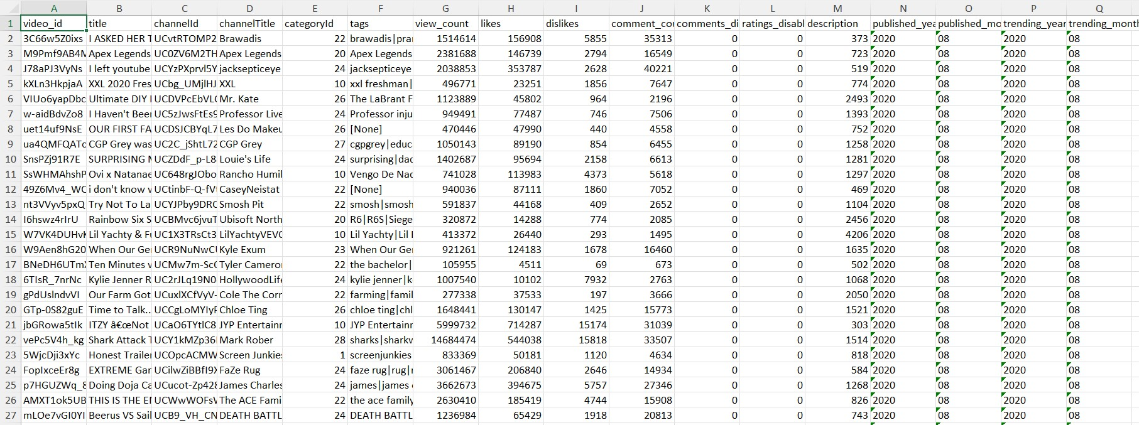
Cleaning, Transforming, loading
Transformed dataset.

Slide 5
Visualization
Frequency Distribution with respect to unique rags in the tags column.
View Count Distribution with respect to unique tags in the tags column.

Slide 6
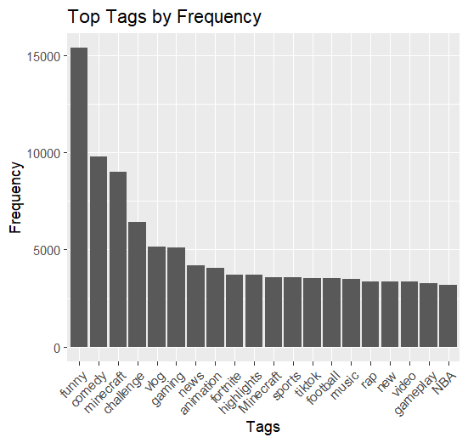
Visualization
Frequency Distribution with respect to unique rags in the tags column.

Slide 7
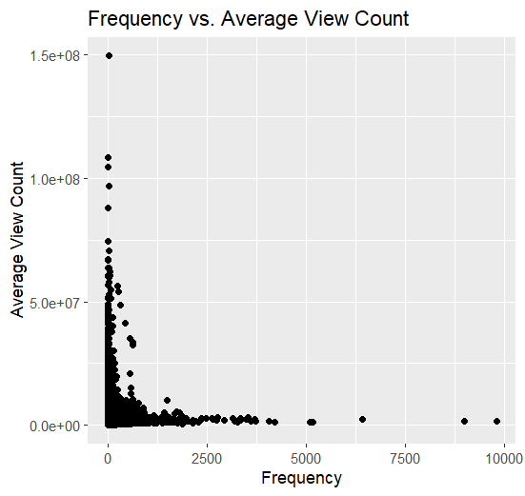
Visualization
View Count Distribution with respect to unique tags in the tags column.

Slide 8
Spearman’s test
Spearman's rank correlation rho data: combined_data$frequency and combined_data$average_view_count
S = 1.0481e+13, p-value < 2.2e-16
alternative hypothesis: true rho is not equal to 0
sample estimates: rho 0.2960039 positively correlation (-1 to 1)
There is a statistically significant positive correlation (rho = 0.2967) between tag frequency and average view count. #As one value increase the other value cannot increase(monotonic association between ranked variables)

Slide 9
Thank You. Please ask questions and share some feedbacks.

